Slide 1
Forecasting Store Sales: Does Weather make an impact?
VIKASH PATEL

Slide 2
Breaking down the problem
Store managers are always searching to find the optimal levels for their inventories
Never want to find yourself out of stock of heavily demanded items
You also don’t want to hold on to perishable items past their sale date
What kind of an effect does weather have on sales?
Is it enough of an effect to cause out of stock situations, or do sales remain the same?
If not weather, are there other factors that are more influential to customers going shopping?
This problem is very interesting to me from a business perspective:
I would like to understand how different outside factors can influence strategic operations
I am interested in a career in data science, specifically in retail or real estate, so this case study will give me an opportunity to work with a relevant issue within the retail sphere.

Slide 3
Using data to find insights
Understanding and quantifying the relationship between outside factor and sales can lead to better inventory management across all packaged consumer goods stores.
Like weather, weekends, holidays, etc.
For this case study, I was able to obtain sales data from Walmart via one of their Kaggle competitions. The following datasets were included:
Sales data of 111 items for 45 different stores
Weather data for 20 weather stations
Key data mapping each store to its respective weather station.
Also, a disclaimer in the sales dataset noted that item numbers are not consistent for each store, meaning item 1 at store 1 may not be the same item as item 1 at store 5.
This prevented me from looking at overall item trends across different stores.

Slide 4
Cleaning up data
Weather data:
Out of the various data points contained in the dataset, I utilized just average daily temperature and daily total precipitation.
Days with missing weather data were completely dropped.
Hard to justify using any missing value replacement function.
Inaccurate weather data could potential skew results and lead to flawed conclusions.
Sales data:
Working through the data, there were an overwhelming amount of observations with missing sales values. These were dropped to ensure a concise derived model later.
Focus shifted towards the analyzing the top 5 items for each store.
These items account for most of each store’s inventory and sales during the year, and therefore are ideal items to analyze and predict for.

Slide 5
Exploratory Analysis
Using station 1 as an example for its temperature and precipitation plot, I got an idea of what kind of weather it was subject to. In general, you have to consider where these stations are generally located by their temperature patterns. This is important to think about since winter weather in colder climates is seen as standard and less likely to cause grocery store rushes, compared to winter weather in warmer climates.

Slide 6
Exploratory Analysis
Using item 9 at store 1 in the year 2012 as an example, you can observe relatively consistent sales through the year, with slight increases in the fall and winter seasons, but not enough to classify it as a seasonal item for any particular season. Conducting this analysis on all top items across stores, 16 seasonal items were found.

Slide 7
Exploratory Analysis
Box plots were used to analyze differences between sales during times of above and below average precipitation. The plots indicated that the data was not close enough to normal, therefore a standard t-test couldn’t be used for the hypothesis. I utilized the Wilcoxon rank sum test for the test, which led me to the conclusion of a statistical significance of precipitation on sales. I included this indicator in my model.

Slide 8
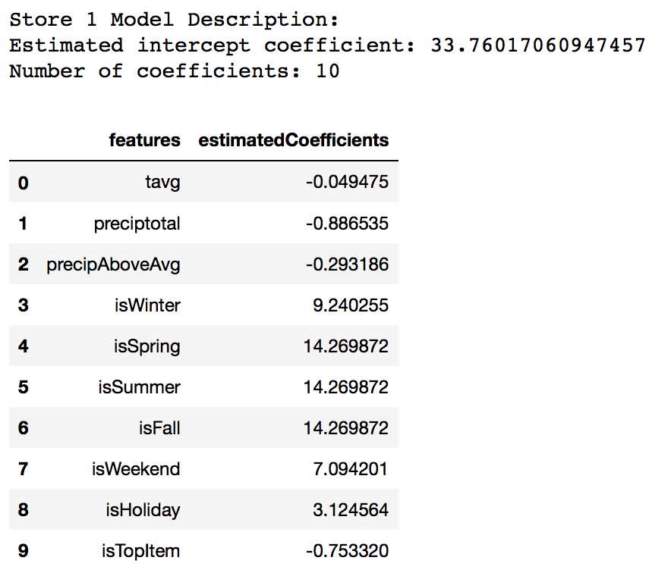
In-Depth Analysis: Regression
Using store 1 as the example once more, the respective model for this store derived the following intercept and coefficients. Each store had its own model derived for its specific items, due to the inconsistency between items numbers across stores. In total, 10 different coefficients were used as features, with 8 of them being indicator variables.

Slide 9
Results
According to the calculated R² values I calculated, I observed a wide range of percentages detailing the variance in sales for each store.
The highest R² calculated was for store 12, with a value of 0.62, where as the lowest was 0.01 for store 37.
Observing the calculated coefficients for store 1, an initial intercept of 33 is extracted.
Weather related features look to have a very minimal effect on the sales output, a negative impact at that.
As expected, seasonal indicators are positive for the respective seasons an item is popular.
Aside from that feature, weekends seem to have the largest positive impact on the sales of items.
This was expected, as people have more leisure time during weekends than during the week.
Also observed is the positive impact on sales that holidays have, however that impact is small in comparison to the impact of weekends.

Slide 10
Recommendations
Despite there being a belief that severe weather causes massive store rushes, I have come to the conclusion that weekends and holidays have more of an impact on sales than weather, as well as when it is peak buying season for certain items.
Therefore, from a business perspective, I would give the following suggestions to store managers:
Do not overestimate weather related inventories, as they sales during these times will not be consistent enough to extract patterns from.
Focus on sustaining inventories during the weekend as this is when stores experience the highest rates of sales, and likely shoppers.
Adequately prepare for holiday shopping, as these are periods of the year that sales are expected to be higher, no matter the type of holiday. This may be due to more leisure time.

Slide 11
Project overview
This was a very interesting case study to work with, one where I was able to really begin applying machine learning techniques to my findings.
While working through the project, I encountered different techniques to analyze data.
Perspectives that I would not have initially thought of when approaching data analysis, but now will try and incorporate in future analysis.
If given more time to make improvements:
I would try and utilize a dynamic predictive model for the stores based on the previous day’s or week’s sales. This is something that I will work on and add to the case study.
This dynamic model would provide more accuracy and would be easier for store managers to implement for short periods of time.
In terms of the dataset, the lack of consistency of item numbers between stores was difficult to work with.
This forced me to conduct store by store analysis.
Analyzing insightful item trends across stores was not possible.

